Slide 1
Reservation orders
May 11th, 2021

Slide 2
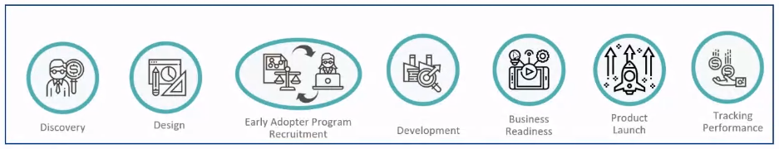
Goal
Decision on design options

Slide 3
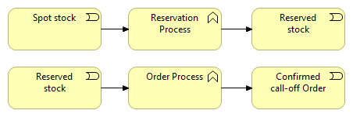
Overall process

Slide 4
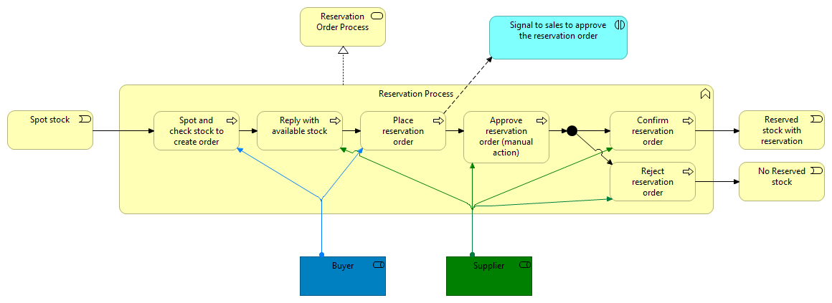
Reservation process

Slide 5
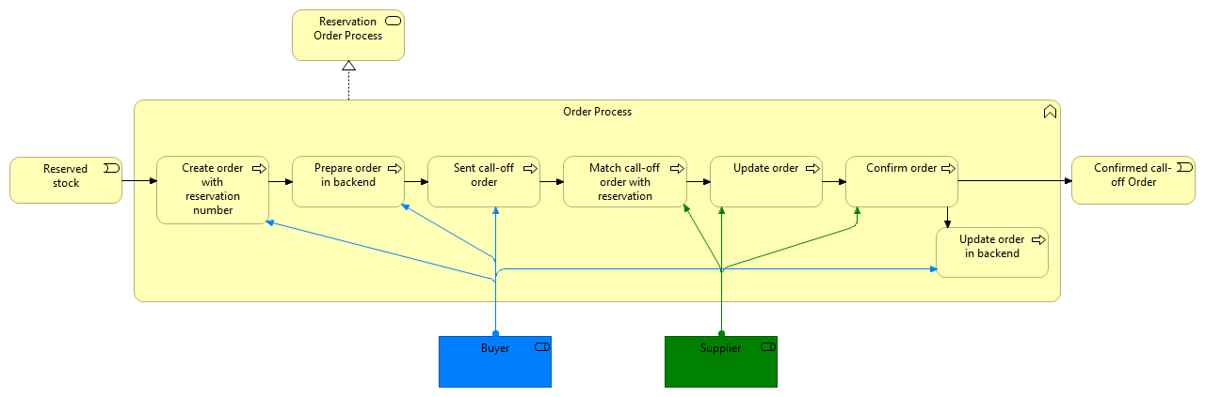
Call-off process

Slide 6
Reservation order

Slide 7
Reservation order confirmation / status

Slide 8
Call-off order

Slide 9
Seller metrics
 | Current average number of reservation orders per day* | Regular average number of reservation orders per day** | Average time savings per order | Current total time saving per day* | Regular total time saving per day**
Seller 1 | 25 | 50 | 3,5 minutes | +/- 1,5 hour | +/- 3 hour
Seller 2 | 20 | 40 | 4 minutes | +/- 1,33 hour | +/- 2,66 hour
*Numbers are lower than normal due to limited stock
**Without stock limitations
Buying motives
Reduction in manual work and errors (not included in the metrics)
Less fragmentation of work
Workload reduction
More and better insight in order processing status and corresponding workload

Slide 10
Buyer metrics
 | Current average number of reservation orders per day* | Regular average number of reservation orders per day** | Average time savings per order | Current total time saving per day* | Regular total time saving per day**
Buyer 1 |  |  |  | +/- 0,4 hour
Buyer 2 | 4 |  | 7,5 minutes | +/- 0,5 hour
Buyer 3
*Numbers are lower than normal due to limited stock
**Without stock limitations
Buying motives
Reduction in manual work and errors (not included in the metrics)
Less fragmentation of work
Workload reduction
More and better insight in order processing status and corresponding workload
Volume of successful reservation order processing increases and adds to higher customer satisfaction

Slide 11
Reservation Order module, 3 options
1. Reservation Order only
2. Call-off Order only
3. Both
Both has a development cost of € 12.480,00
One order type only is standard
Reservation order module required
Notes:
Go-to: PollEv.com/corzijlstra168

Slide 12
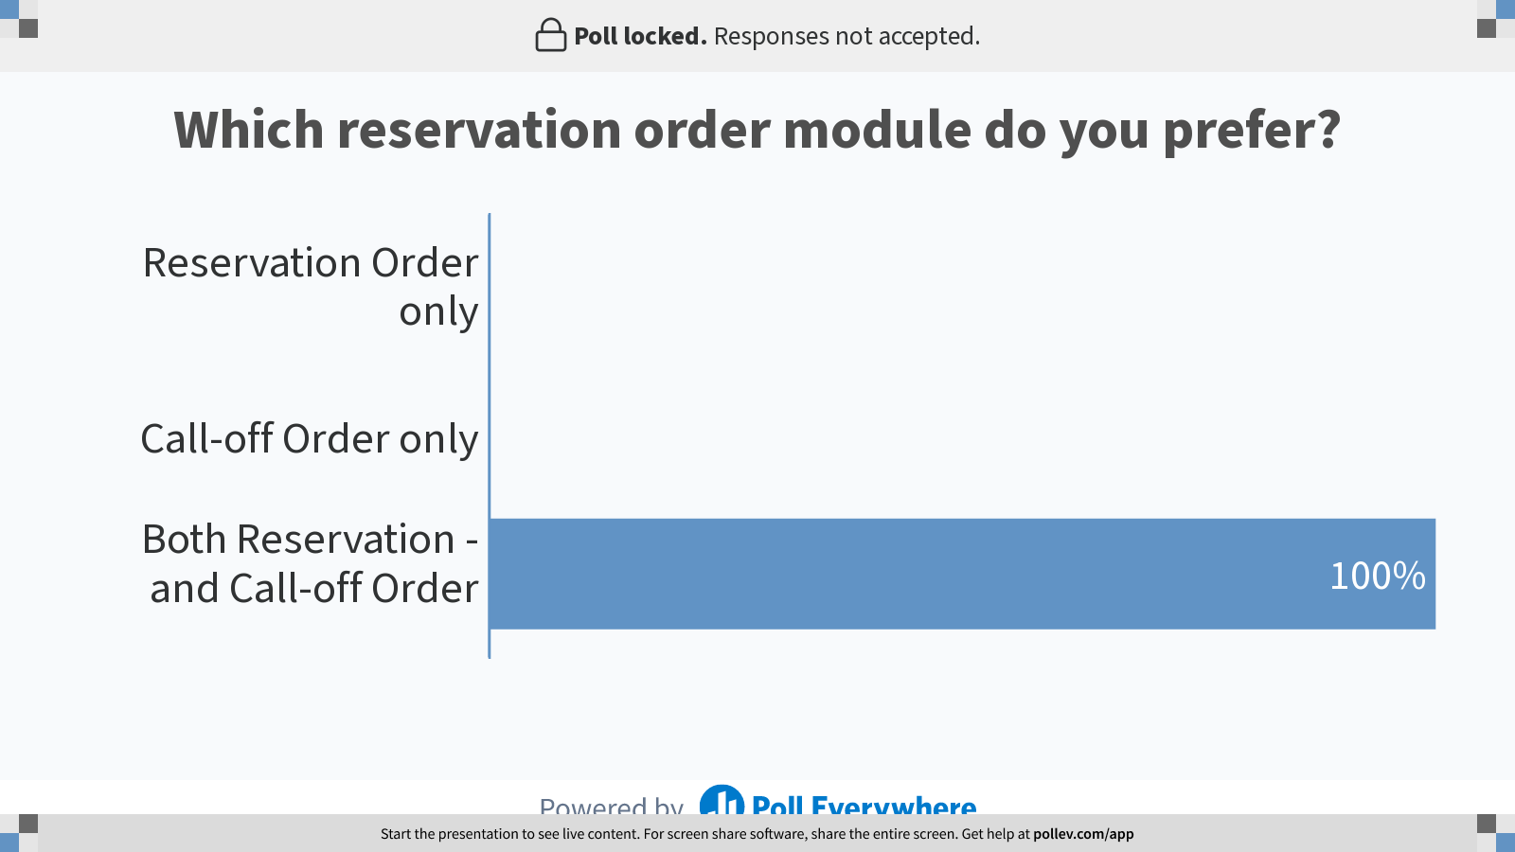
Notes:
Poll Title: Do not modify the notes in this section to avoid tampering with the Poll Everywhere activity.
More info at polleverywhere.com/support
https://www.polleverywhere.com/multiple_choice_polls/Az6Ybe9r0mmzyjSR2vE0Q?flow=Default&onscreen=persist

Slide 13
Next steps
Special order types webinar
Development, if required and enough interest
Implement, test and use

Slide 14

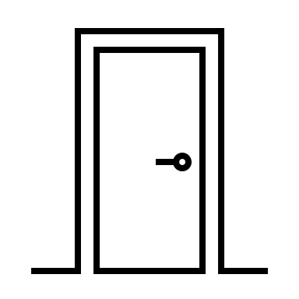



Want to join?
Next customer panel: Proof of Delivery
productmanagement@onetrail.com

